Slide 1
ASSIGNMENT 2
GROUP 1:
Joyal Raju (c0749019)
Merlin Mariam Thankachan (c0748721)
Sruthy Krishnan (c0749122)

Slide 2
Recent technologies in embedded Linux/RTOS.
Wireless Connectivity Cape For Beaglebone Black
NXP Lpcxpresso54628
QNX Neutrino Realtime Operating System (RTOS)

Slide 3
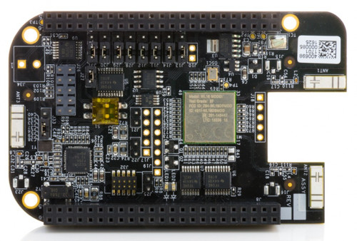
WIRELESS CONNECTIVITY CAPE FOR BEAGLEBONE BLACK
This is an add-on board that provides Wifi and Bluetooth connectivity for Beaglebone black platform.
Manufacturer: element14 (leading electronics distributor)
Price: $67

Slide 4
Features:
2.4GHz and 5GHz Dual-Band WiFi is available
Bluetooth and BLE is available
CC2530 module is embedded for Zigbee and RF4CE applications
RF430CL331 NFC transponder is available to exchange information
In have dual on-board chip antennas & U.FL connectors

Slide 5
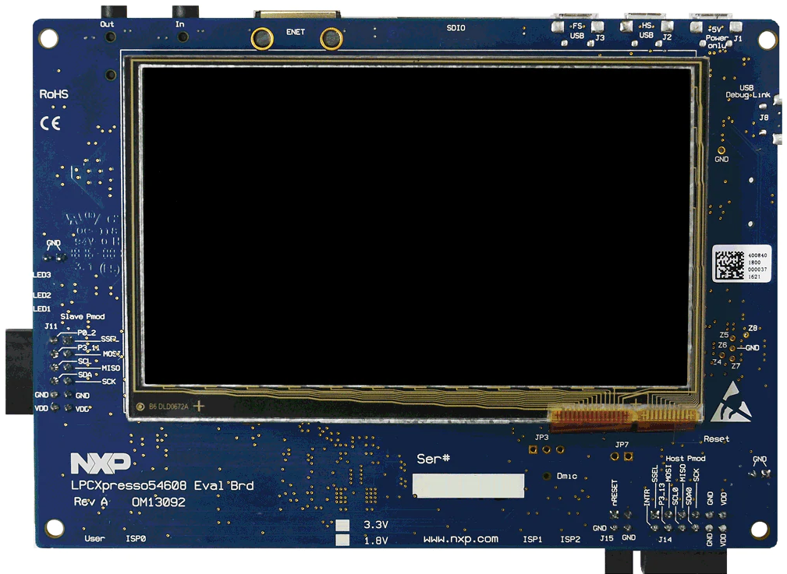
NXP LPCXpresso54628
It is an Arm Mbed-Enabled platform for developing the IoT with open-source embedded OS.
Manufacturer : NXP Semiconductors
Price : 69$

Slide 6
Features:
Processor speed is up to 220MHz
Flexible internal and external memory configurations(512 KB Flash, 200 KB SRAM available)
272x480 color LCD with capacitive touch screen is incorporated
Stereo audio codec with line in/out is available
High speed USB ports are available
10/100 Mbps Ethernet is present
Supports external debug probe

Slide 7
QNX Neutrino Realtime Operating System (RTOS)
One of the most advanced and secure embedded OS for safety and mission critical applications
Developer : Blackberry
Latest release: 2017 March

Slide 8
Features:
Built-in Mission Critical Reliability
Capability to Port Linux Source Code
Different security mechanisms has been layered to achieve the overall security
Realtime support is enabled by precise control over timing
Supports C/C++, java, python, HTML5
Supports a wide range of popular multiprocessor SOCs and boards

Slide 9
REFERENCES
1. JWATSON. (2016 Sep). Wireless Connectivity Cape for Beaglebone Black. Retrieved from
https://www.element14.com/community/docs/DOC-79264/l/wireless-connectivity-cape-for-beaglebone-black
2. Arm MBED. (2019 Aug). NXP LPCXpresso54628. Retrieved from
https://os.mbed.com/platforms/LPCXpresso54628/
3. Blackberry QNX. (2018 ) QNX Neutrino Realtime Operating System (RTOS). Retrieved from
https://blackberry.qnx.com/en/software-solutions/embedded-software/industrial/qnx-neutrino-rtos

